Slide 1

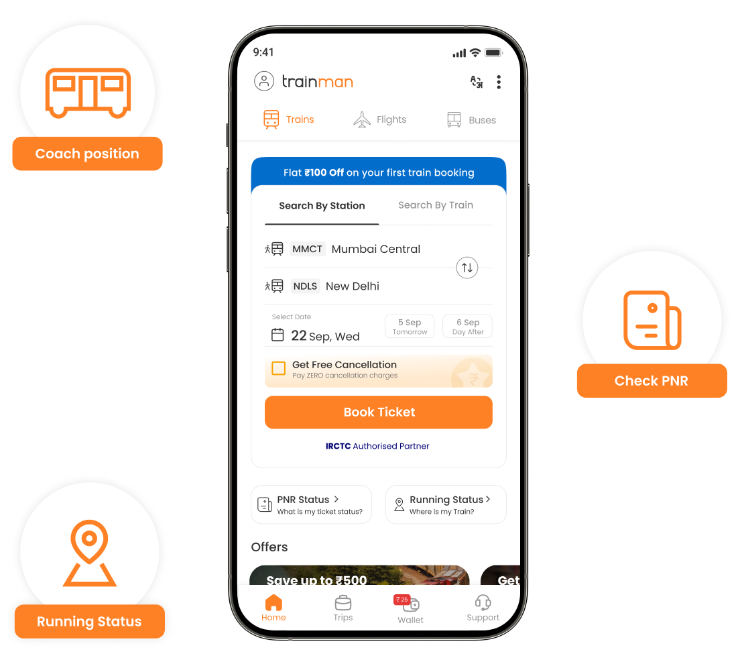
ONLINE TICKET BOOKING SYSTEM
Presented by :-
M. VENKATA SAI
192110433
CSA0936_Java Programming

Slide 2
S.NO | Topics | Page numbers
1 | Problem Description and project Requirements
2 | Source code
3 | Screenshot
4 | Readme File Content

Slide 3
Abstract:-
This abstract introduces an online ticket booking system designed to streamline the process of ticket reservations for various events and services, enhancing user convenience and accessibility.
Key Features: The system incorporates essential features such as user registration, event/service listings with detailed information, secure booking and payment processing, seat selection for assigned seating events, and comprehensive ticket management options.
Benefits: Users can enjoy the convenience of browsing and booking tickets online from a wide range of events and services, with the flexibility to choose seats, make secure payments, receive instant booking confirmations, and manage their tickets efficiently.
Admin Functionality: The system also includes an admin panel for efficient management of user accounts, event/service listings, ticket inventory, pricing, payment transactions, and generation of reports for monitoring system performance.
Impact: By leveraging technology to simplify ticket booking processes and provide a seamless user experience, this online ticket booking system aims to enhance customer satisfaction, increase ticket sales, and improve overall operational efficiency for event organizers and service providers.

Slide 4
INTRODUCTION:-
The Java code provided below outlines the core framework of an online ticket booking system, a vital component in modern-day convenience and efficiency for reserving tickets across a spectrum of events and services. In today's digital era, where accessibility and user experience are paramount, such systems are instrumental in simplifying the ticket booking process and enhancing customer satisfaction.
The code commences by defining a Ticket class, encapsulating crucial attributes such as event name, date, venue, price, and availability. Subsequently, a Booking System class is introduced to oversee ticket management operations. This class incorporates methods for adding tickets to the system and displaying available tickets, laying a solid foundation for a robust ticket booking platform.

Slide 5
EXPLANATION :-
Certainly, here are the key points about the provided Java code:
User Registration: The system allows users to register by providing their personal details such as name, contact information, and email address.
Service Selection: Users can browse through available services, such as hotel rooms, flight tickets, or event bookings, and select their desired options.
Date and Time Selection: Users can choose the date and time for their reservation, depending on the availability of the selected service.
Payment Processing: The system integrates secure payment gateways, enabling users to make payments online using credit/debit cards, digital wallets, or other payment methods.
Booking Confirmation: After successful payment, users receive a booking confirmation via email or SMS, containing details of their reservation, booking ID, and any additional information.

Slide 6
SOURCE CODE :-
import java.util.Scanner;
class TicketBookingSystem {
private static int availableTickets = 10;
public static void main(String[] args) {
Scanner scanner = new Scanner(System.in);
while (true) {
System.out.println("1. Book Ticket");
System.out.println("2. Exit");
System.out.print("Enter your choice: ");
int choice = scanner.nextInt();

Slide 7
switch (choice) {
case 1:
bookTicket();
break;
case 2:
System.out.println("Exiting...");
return;
default:
System.out.println("Invalid choice! Please enter 1 or 2.");
}
}
}
private static void bookTicket() {
if (availableTickets > 0) {

Slide 8
Scanner scanner = new Scanner(System.in);
System.out.print("Enter the number of tickets you want to book: ");
int ticketsToBook = scanner.nextInt();
if (ticketsToBook > availableTickets) {
System.out.println("Sorry, only " + availableTickets + " tickets available.");
} else {
System.out.println(ticketsToBook + " ticket(s) booked successfully!");
availableTickets -= ticketsToBook;
System.out.println("Available tickets now: " + availableTickets);
}
} else {
System.out.println("Sorry, no tickets available!");
}

Slide 9
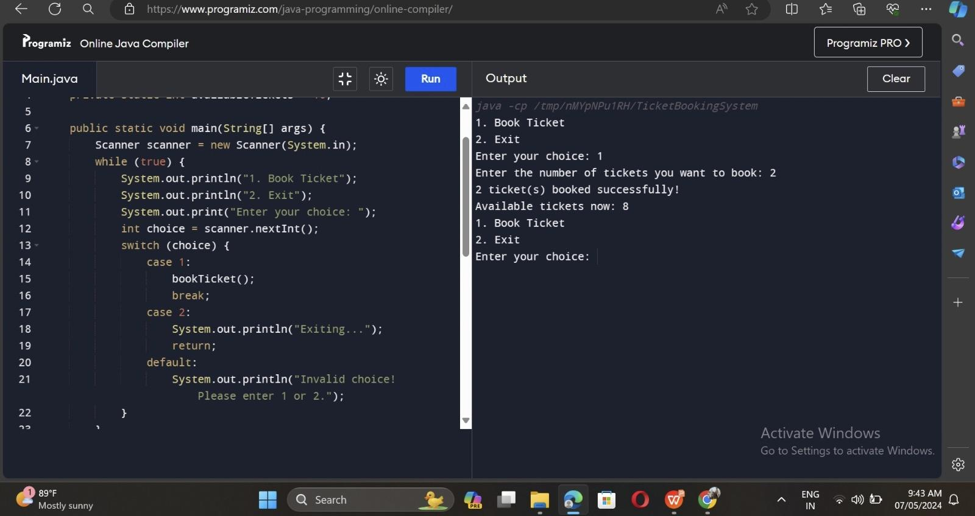
OUTPUT :-

Slide 10
CONCLUSION :-
In conclusion, the online reservation system described above offers a seamless and convenient way for users to book services such as hotel accommodations, flight tickets, or event reservations. By providing user-friendly interfaces, secure payment processing, and instant booking confirmations, the system enhances the overall booking experience for users.
Additionally, the system streamlines the reservation process, reducing manual errors and increasing efficiency for both users and service providers. Its ability to handle date and time selections, integrate payment gateways, and generate booking confirmations ensures a smooth and reliable booking process.
Overall, the online reservation system represents a modern and efficient solution for managing reservations, catering to the needs of users seeking hassle-free booking experiences across various services and industries.

